Slide 1

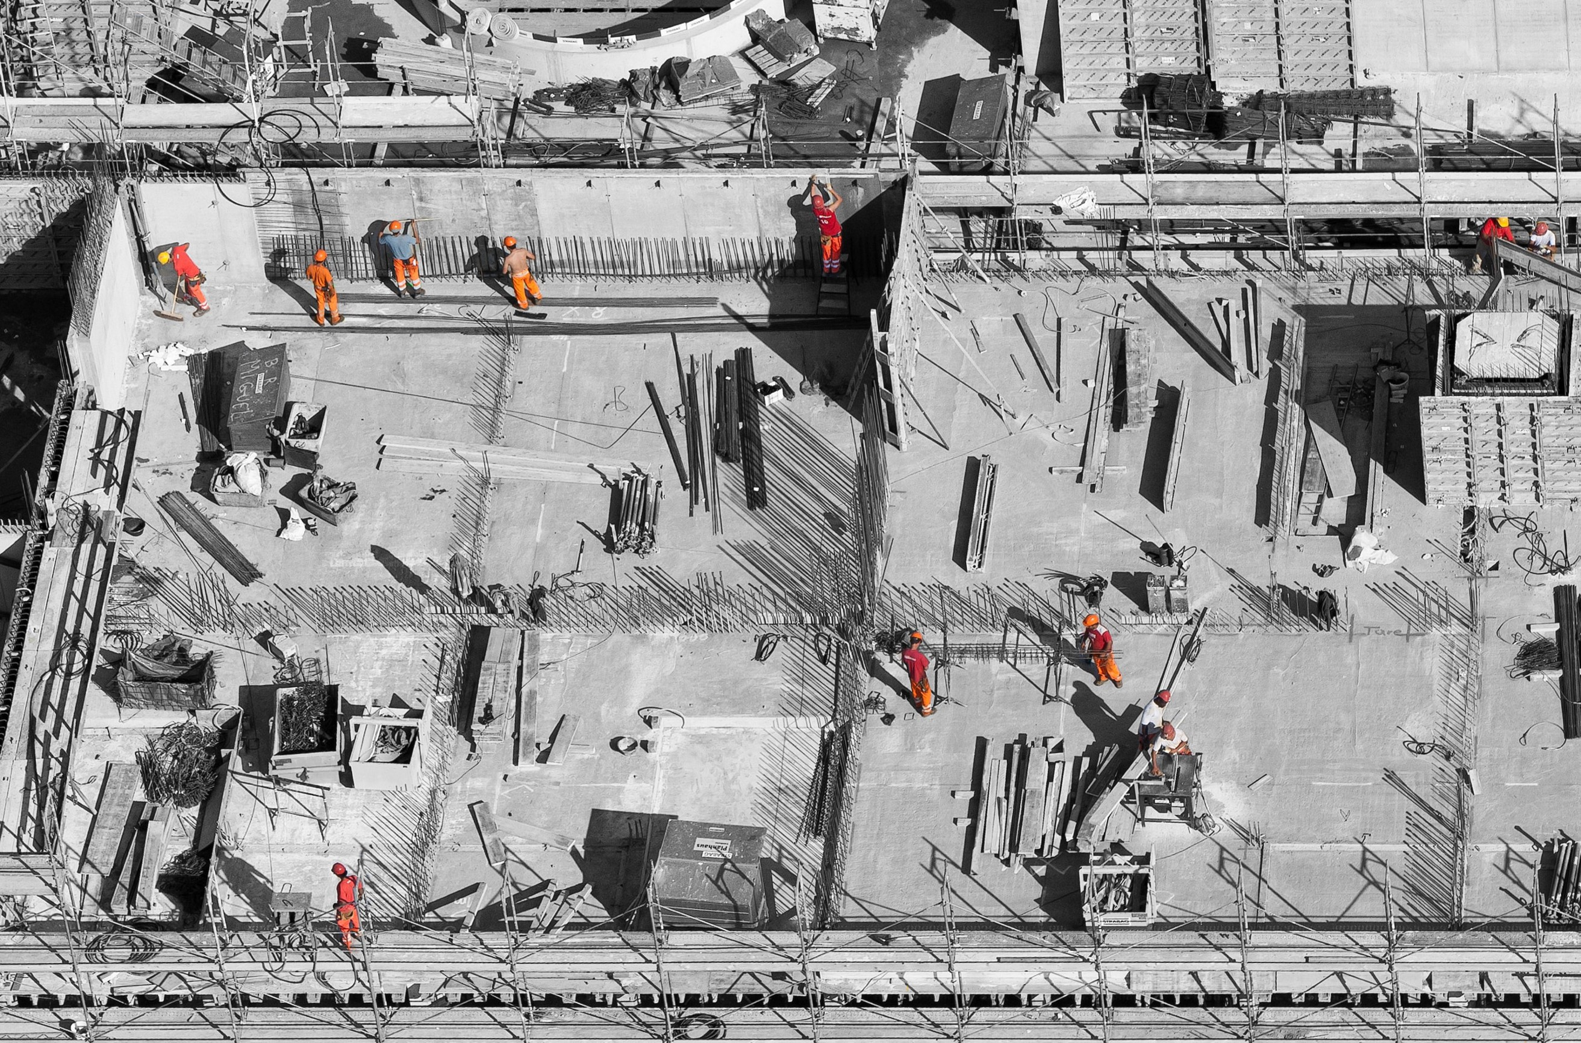
Vaagdevi Engineering College
PREDICTING COMPRESSIVE STRENGTH OF CONCRETE
Presented by
J. Sai Keerthi (18UK1A05N3)
T. Sudeepa (18UK1A05M4)
P. Yashwanth (18UK1A05L3)
S. Ramakrishna (18UK1A05M2)
Submitted for the partial fulfillment
of
Bachelor Of Technology
in
Computer Science Engineering
Computer Science Engineering
July - 2021

Slide 2
1.INTRODUCTION
In our project, we aim to predict the outcome of Predicting Compressive Strength Of Concrete using machine learning, As a data scientist, we generally faced many real-life problems, like- some social issue, construction, etc.. we have to solve this type of problem using machine learning techniques, let’s we take an example of construction, what will you refer the word construction? it is the art and science to form objects, systems, or organizations. what will you imagine from the word construction is that mega buildings, machines, material, etc… but you know that what is used to build these mega buildings, for construction we use material, cement, iron rods, etc.. where the material is a most important part of building making.
Computer Science Engineering
July - 2021
2

Slide 3
2. Abstract
” Use the best possible materials, and reveal the quality of those materials
and the craftsmanship of their assembly “.
The meaning of these beautiful words is that if we use the best quality material then you probably be the quality constructor. We can relate this quote with our example, we discuss above that certain things are used for making mega buildings but the material is most important.
Title of project
Month - Year
3

Slide 4
3. PURPOSE
Our aim from the project is to make use of pandas, matplotlib, numpy, & seaborn libraries from python to extract the libraries for machine learning for Predicting the compressive strength of concrete.
So, we are going to analyze the Concrete Compressive Strength dataset and build a Machine Learning model to predict the quality.
Computer Science Engineering
July - 2021
4

Slide 5
4. Theory and fundamentals
Material which is nature and man mad we will talk about man-mad material, in this concrete is most important man-mad material for building. concrete is made up of three basic components Water, aggregate, and Portland
cement. We know quality is the most important property for material used in building, if the quality of concrete is less then the build can’t stable but if we use the best quality concrete then the building is stable.
In easy words the Compressive Strength of Concrete determines the quality of Concrete, we check it by standard crushing test on a concrete cylinder. Concrete strength is also considered a key factor in obtaining the desired durability. For testing strength it will take 28 days this is a large time, So what we will do now? By use of Data Science, we reduce this lot’s of effort we will predict that in how much quantity we have to use which raw material for good compressive strength.
Computer Science Engineering
July - 2021
5

Slide 6
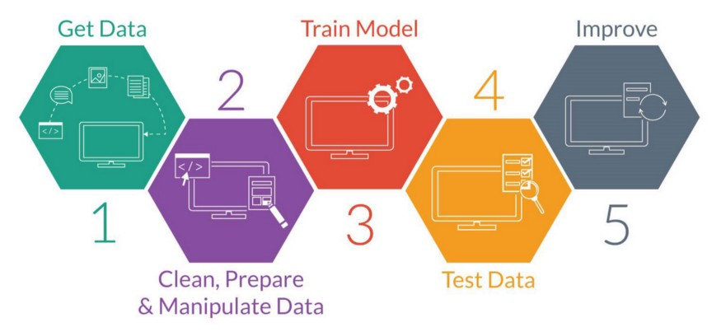
5. PROCESS FLOW
Computer Science Engineering
July - 2021
6

Slide 7
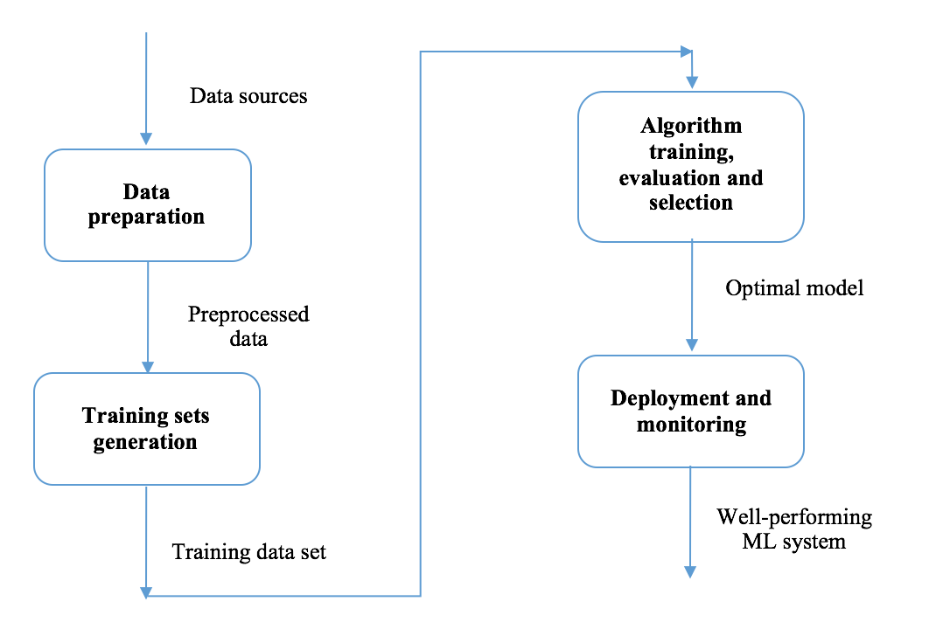
6. Methodology
Dataset
Dataset knowledge
Importing Modules
Reading data
Study Dataset
Handling Null values
Data Visualization
Splitting the data
Feature Scaling
Applying model
Saving the Model
Deployment with flask
Computer Science Engineering
July - 2021
7

Slide 8
7. Tools and technologies
Dataset:
We will use a concrete compressive strength dataset which was retrieved from the Kaggle.
Dataset knowledge: you see that several features affect the quality of concrete. So we discuss brief of each feature:
cement: a substance used for construction that hardens to other materials to bind them together.
slag: Mixture of metal oxides and silicon dioxide.
Flyash: coal combustion product that is composed of the particulates that are driven out of coal-fired boilers together with the flue gases.
Water: It is used to form a thick paste.
Superplasticizer: used in making high-strength concrete.
Coaseseaggregate: prices of rocks obtain from ground deposits.
fineaggregate: the size of aggregate small than 4.75mm.
age: Rate of gain of strength is faster to start with and the rate gets reduced with age.
csMPa: Measurement unit of concrete strength.
Computer Science Engineering
July - 2021
8

Slide 9
8. Tools and technologies
Importing Modules
import pandas as pd
import numpy as np
import matplotlib.pylot as plt
import seaborn as sb
So, we import pandas for data analysis, NumPy for calculating N-dimensional array, seaborn, and matplotlib to visualize the data.
Reading data
Generally, we use a dataset in the form of a CSV file, for reading this CSV file we will use the panda’s library
Study Dataset
After reading the dataset we have to extract information from the data
Handling Null values
we handle the null values that are present in the dataset for better accuracy
Computer Science Engineering
July - 2021
9

Slide 10
9.Data analysis
Data Visualization
it is an approach of analyzing datasets to summarize their main characteristics.
Pair plot:
It plots a pairwise relationship in the dataset, it will create a grid of axis where the y-axis belongs to row and the x-axis belongs to columns
Scatter Plot
This plot displays the relationship between any two sets of data
Correlation plot
The correlation plot shows the correlation coefficient between variables. This plot contains the correlation matrix-like table.
Box plot
we plot the outlier that is present inside the dataset.
Computer Science Engineering
July - 2021
10

Slide 11
10. Training and Testing
Splitting the data
we use the scikit-learn module train_test_split, which is used for splitting the training and testing parts
Dividing Dependent And Independent Variables
Independent variables contain a list of those variables in which concrete quality is dependent.
The dependent variable is that variable that is dependent on other variables’ values.
1. Independent variables are cement, flyash, water, superplasticizer, coaseseaggregate, fineaggregate, age.
2. dependent variable is the only csMPa
Feature Scaling
We do scaling of data for balancing the data points.
Computer Science Engineering
July - 2021
11

Slide 12
11. Model Building
Applying model
Machine learning consists of algorithms that can automate analytical model building. Using algorithms that iteratively learn from data. In this step, we applying several machine learning algorithms to training data.
In this project we will use Linear Regression, Lasso Regression, Ridge Regression, RandomForestRegressor for model building.
The accuracy score of RandomForestRegressor is highest among linear, lasso, and ridge regression, so we use the RandomForestRegressor model, Here the highest accuracy means it predicts the quality of concert by using training, which contains independent variables, and also it gives less error rate.
We use RandomForestRegressor for Predicting compressive strength of concrete.
Computer Science Engineering
July - 2021
12

Slide 13
12. Conclusion
Saving the Model
we save our machine learning model using pickle
Deployment using flask
In the end, we want our model to be available for the end-users so that they can make use of it. Model Deployment is one of the last stages of any machine learning project and can be a little tricky. How do you get your machine learning model to your client/stakeholder? What are the different things you need to take care of when putting your model into production? And how can you even begin to deploy a model?
Here comes the role of Flask.
Computer Science Engineering
July - 2021
13

Slide 14
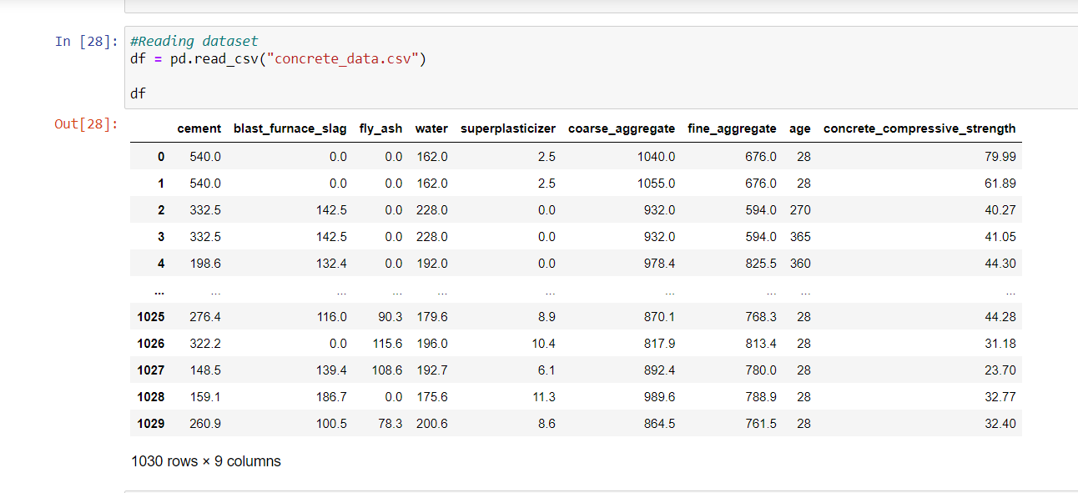
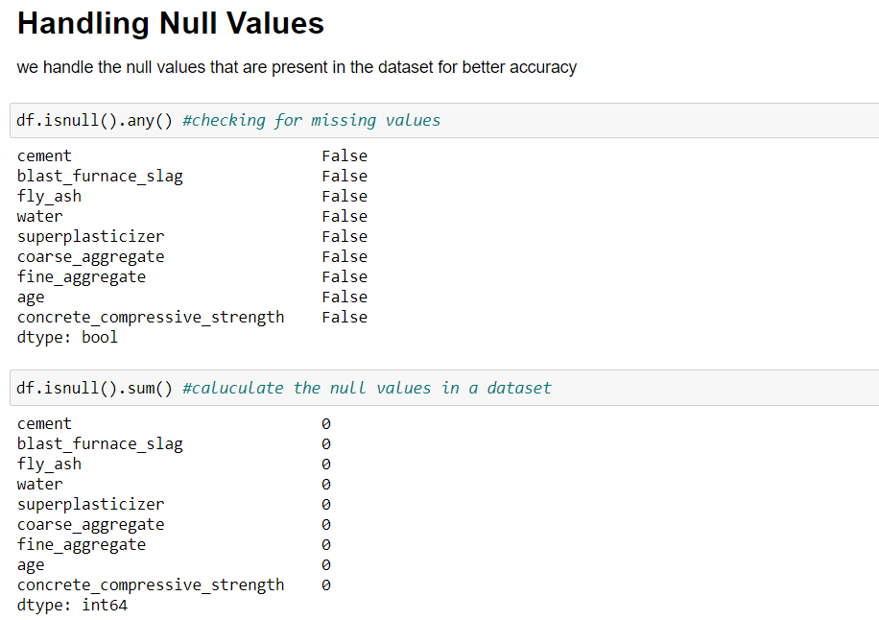
13. Project Screenshots
Computer Science Engineering
July - 2021
14

Slide 15
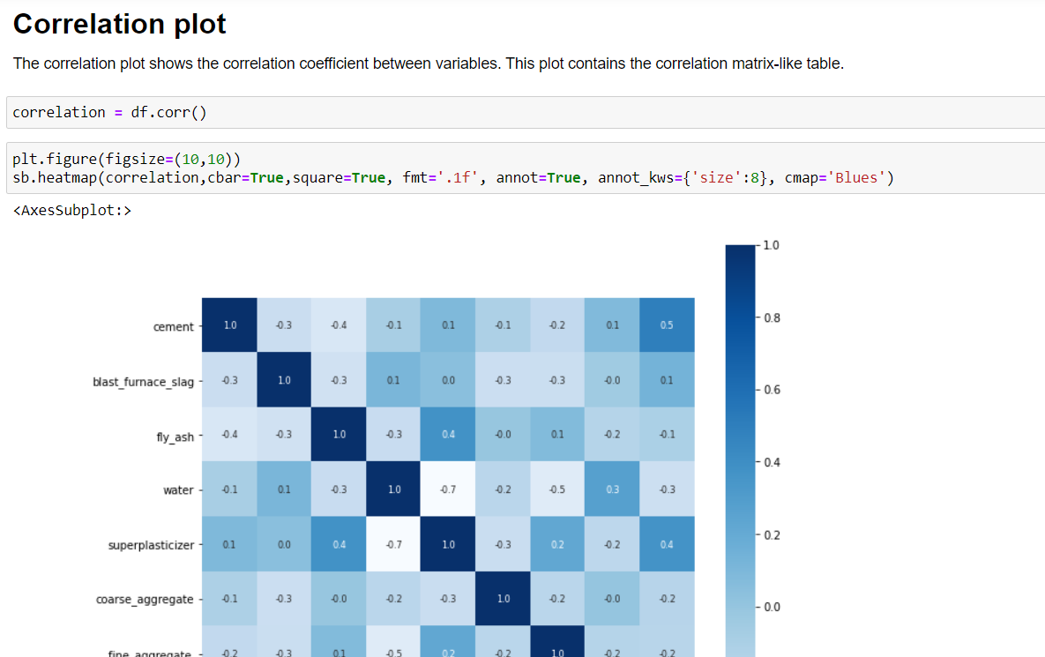
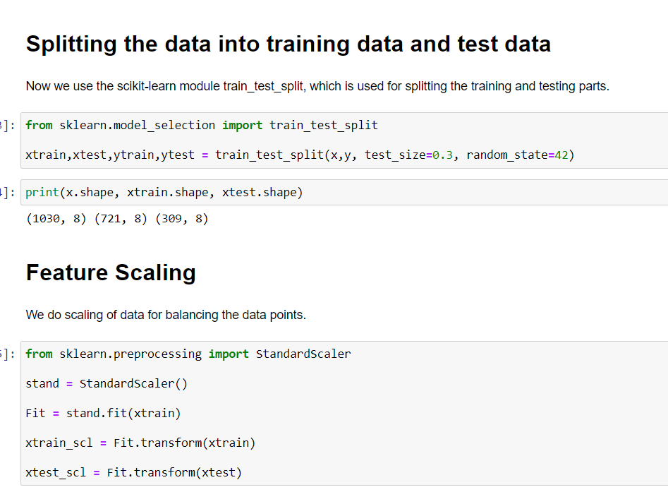
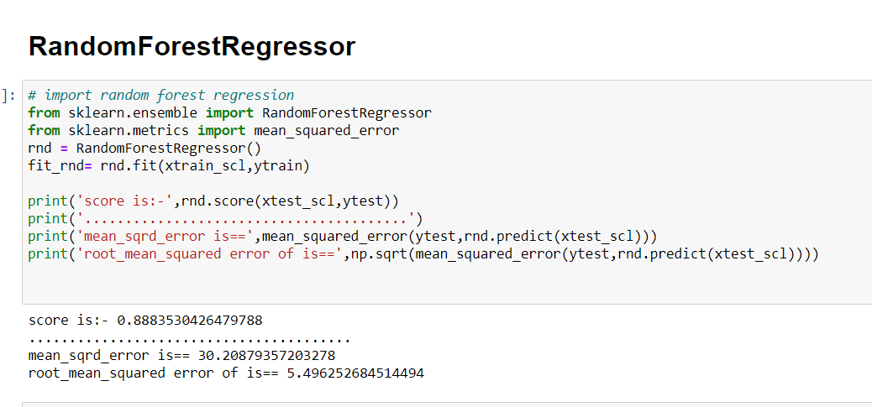
14. Project Screenshots
Title of project
Month - Year
15

Slide 16
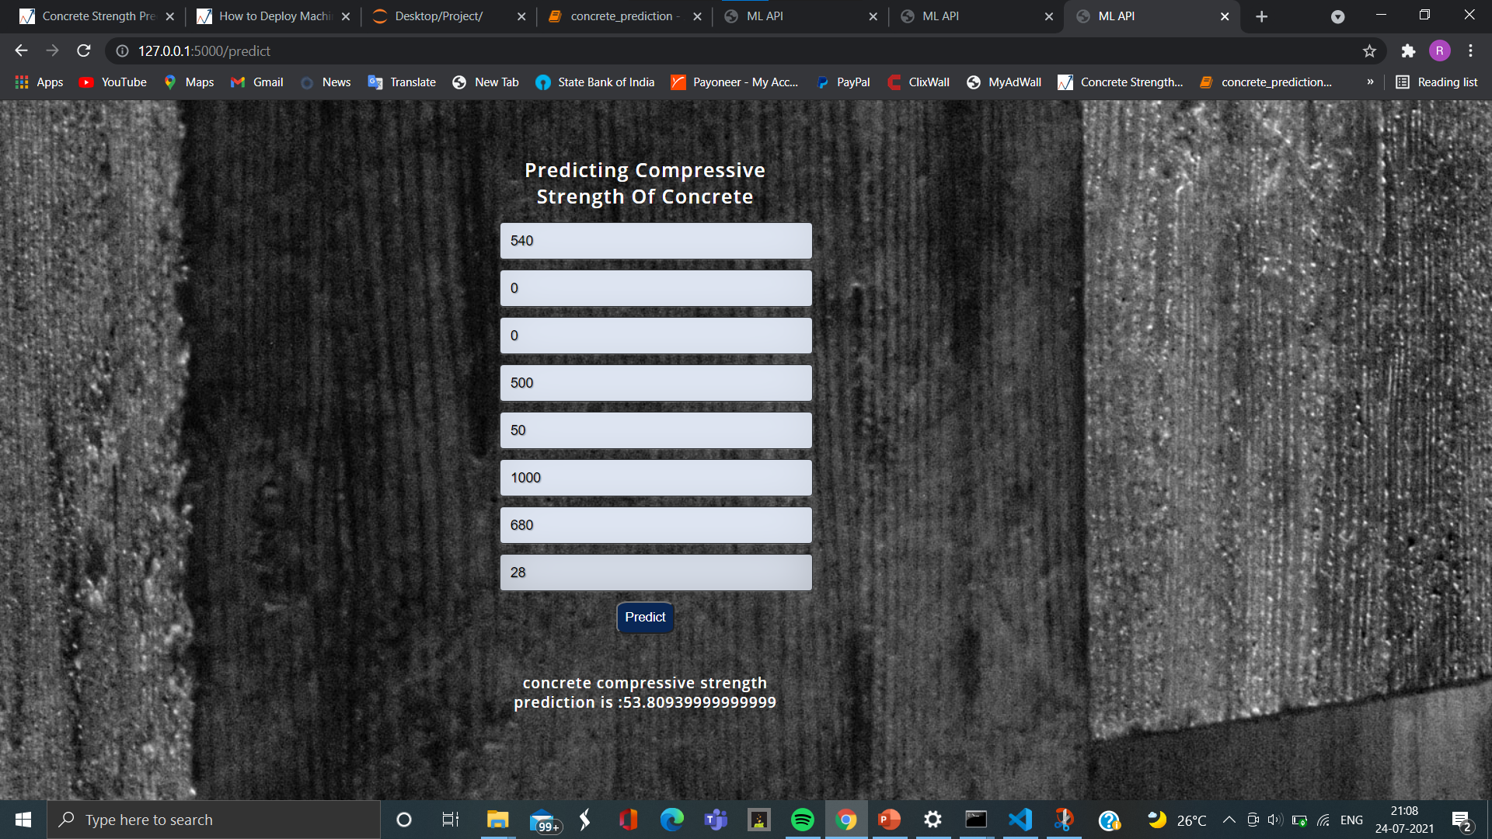
14.Final Result
Computer Science Engineering
July - 2021
16

Slide 17


